Slide 1
Project Overview
Title: 21×21 Keyboard Matrix Controller using Verilog
• A keyboard controller for a 21×21 matrix keypad (441 keys)
• Scans rows and columns to detect pressed keys
• Uses Verilog HDL for FPGA implementation or simulation
• Built by expanding the concept of a 3×3 keypad controller

Slide 2
How a Matrix Keypad Works
• Keys arranged in rows and columns
• Columns are inputs with pull‑up resistors (idle HIGH)
• Rows are outputs activated one at a time
• Pressing a key pulls the corresponding column LOW
• Active row + LOW column = key pressed

Slide 3
Scanning Method
1. All rows are HIGH initially
2. One row is pulled LOW
3. All columns are read
4. If any column reads LOW → key in that row is pressed
5. Move to next row and repeat for all 21 rows
6. Continuous scanning detects keys in real time

Slide 4
Debouncing Using Counter
• Mechanical switches cause bouncing (unstable LOW/HIGH)
• Counter delays row switching to stabilize readings
• Prevents false key detection
• Ensures clean and reliable key press capture

Slide 5
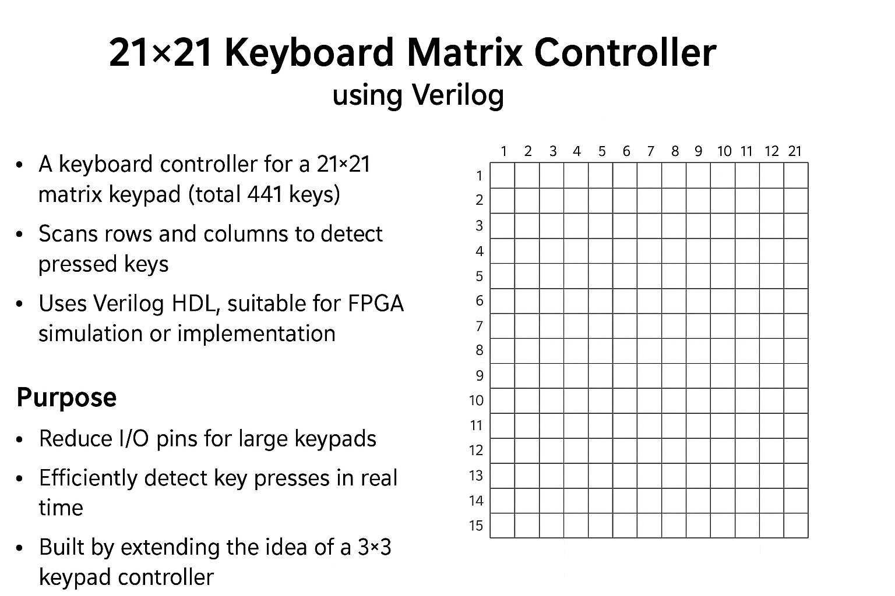
Visual Diagram
Below is the 21×21 keyboard matrix image

Slide 6
Design Components
Inputs:
• clk
• col[20:0]
Outputs:
• row[20:0]
• key_state[440:0]
Registers:
• scan_row – selects which row is active
• counter – timing control and debouncing

Slide 7
Verilog Logic Flow
always @(posedge clk):
• Increment counter
• When counter hits limit → scan next row
• case(scan_row) sets active row LOW
• case(scan_row) reads column values
• Store values in key_state
• Repeat for all 21 rows

Slide 8
Full Verilog Code
module keyboard21x21 (
input clk,
input [20:0] col,
output reg [20:0] row,
output reg [440:0] key_state
);
reg [4:0] scan_row = 0;
reg [15:0] counter = 0;
always @(posedge clk) begin
counter <= counter + 1;
if (counter == 50000) begin
counter <= 0;
row <= 21'b111111111111111111111;
case (scan_row)
5'd0: row <= 21'b111111111111111111110;
5'd1: row <= 21'b111111111111111111101;
5'd2: row <= 21'b111111111111111111011;
5'd3: row <= 21'b111111111111111110111;
5'd4: row <= 21'b111111111111111101111;
5'd5: row <= 21'b111111111111111011111;
5'd6: row <= 21'b111111111111110111111;
5'd7: row <= 21'b111111111111101111111;

Slide 9
Full Verilog Code
5'd8: row <= 21'b111111111111011111111;
5'd9: row <= 21'b111111111110111111111;
5'd10: row <= 21'b111111111101111111111;
5'd11: row <= 21'b111111111011111111111;
5'd12: row <= 21'b111111110111111111111;
5'd13: row <= 21'b111111101111111111111;
5'd14: row <= 21'b111111011111111111111;
5'd15: row <= 21'b111110111111111111111;
5'd16: row <= 21'b111101111111111111111;
5'd17: row <= 21'b111011111111111111111;
5'd18: row <= 21'b110111111111111111111;
5'd19: row <= 21'b101111111111111111111;
5'd20: row <= 21'b011111111111111111111;
endcase
case (scan_row)
5'd0: key_state[20:0] <= ~col;
5'd1: key_state[41:21] <= ~col;
5'd2: key_state[62:42] <= ~col;
5'd3: key_state[83:63] <= ~col;
5'd4: key_state[104:84] <= ~col;
5'd5: key_state[125:105] <= ~col;
5'd6: key_state[146:126] <= ~col;

Slide 10
Full Verilog Code
5'd7: key_state[167:147] <= ~col;
5'd8: key_state[188:168] <= ~col;
5'd9: key_state[209:189] <= ~col;
5'd10: key_state[230:210] <= ~col;
5'd11: key_state[251:231] <= ~col;
5'd12: key_state[272:252] <= ~col;
5'd13: key_state[293:273] <= ~col;
5'd14: key_state[314:294] <= ~col;
5'd15: key_state[335:315] <= ~col;
5'd16: key_state[356:336] <= ~col;
5'd17: key_state[377:357] <= ~col;
5'd18: key_state[398:378] <= ~col;
5'd19: key_state[419:399] <= ~col;
5'd20: key_state[440:420] <= ~col;
endcase
scan_row <= (scan_row == 20) ? 0 : scan_row + 1;
end
end
endmodule

